Slide 1
Introduction To Website Development Technologies

Slide 2

HELLO!
I am Trevoir Williams
Software Engineer | Lecturer

Slide 3
Course Objectives
What is HTML
Publish online documents with headings, text, tables, lists, photos, etc.
Retrieve online information via hypertext links, at the click of a button.
What is CSS
CSS is the language for describing the presentation of Web pages, including colors, layout, and fonts.
CSS makes it easier to maintain sites, share style sheets across pages, and tailor pages to different environments.
Custom frameworks like Bootstrap, Material, etc.

Slide 4
Course Objectives
What is JavaScript
JavaScript is the world's most popular programming language.
JavaScript is the programming language of the Web.
JavaScript is easy to learn.
What is Bootstrap
Bootstrap, which is the most popular HTML, CSS, and JavaScript framework for creating responsive, mobile-first websites.

Slide 5
Visual Studio Code
What
A Microsoft open-source text editor that is chock full of plugins and tools to make you as productive as possible when building websites.
Why
Powerful Web Tools to allow development with ASP.NET, jQuery, Bootstrap, among other popular frameworks.
Git Integration - Manage your source code in Git repos hosted by any provider, including GitHub.

Slide 6
Other Techhnologies
GitHub
Source or Version Control is a system that records changes to files over time so that you can recall specific versions later
Netlify
An all-in-one platform for automating modern web projects.
Notes:
Source or Version Control is a system that records changes to files over time so that you can recall specific versions later
GitHub brings teams together to work through problems, move ideas forward, and learn from each other along the way.
Allows you to:
Track Changes to your project
Collaborate with a team member
Centrally host your code for your team
Manage project documentation

Slide 7
Why Learn Web Development?
1

Slide 8
Involves the creation and maintenance of websites
Allows you to actively contribute to content on the internet
Play a crucial role in shaping interactions with digital content

Slide 9
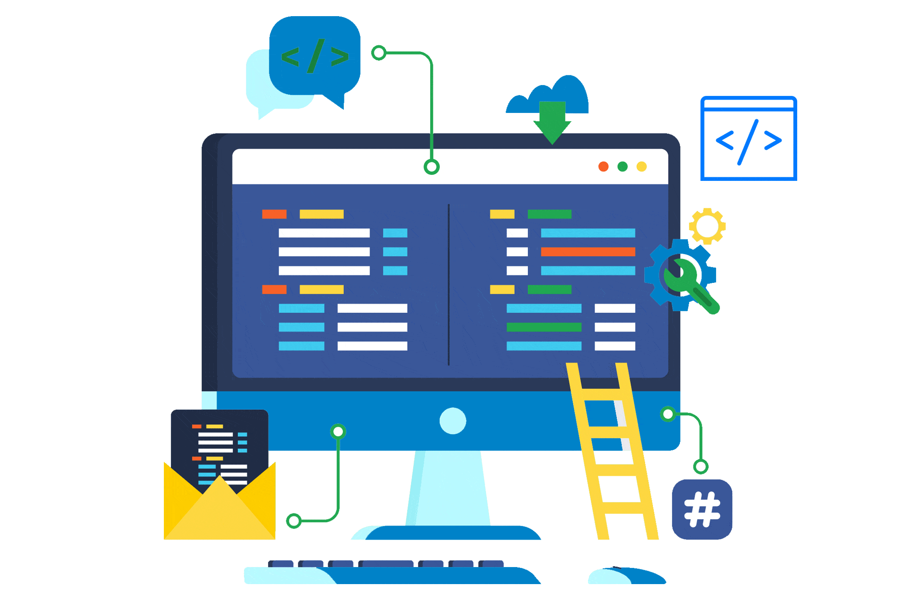
What Are Web Technologies
Tools that facilitate communication and interaction
Browsers, HTML, CSS, JavaScript, etc.
Facilitates global reach
Understand Frontend Technologies
HTML, CSS, and JavaScript are fundamental languages
HTML is for the content
CSS is to style the content
JavaScript is to add interactivity

Slide 10
Several job opportunities exist for this skillset
Easy to use for both personal and professional purposes

Slide 11
Web Development Tools
Any text editor is valid
Notepad, Notepad++, even Microsoft Word
Files need specific extensions:
.html, .css, .js
An Integrated Development Environment (IDE) is best.
Brackets.io, Atom Editor, Sublime, Visual Studio Code

Slide 12
Visual Studio Code
Lightweight
Cross-Platform
Extensible
Git integration
Well maintained by Microsoft and the developer community
Browser based option
Notes:
Why Learn .NET Core and Blazor as opposed to

Slide 13
Explore HTML
1

Slide 14
What is HTML
Short for HyperText Markup Language
Standard language for authoring web pages
Defines the structure of web content
Images, text, tables, forms, etc.
Lightweight and easy to learn
Often assisted by CSS and JavaScript

Slide 15
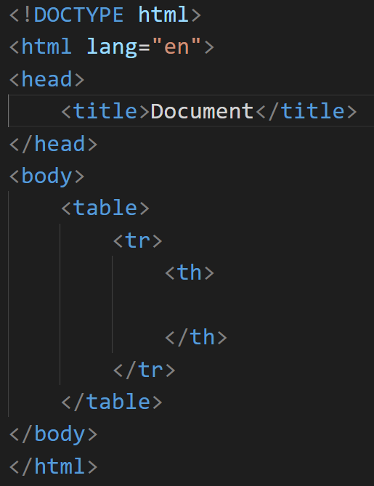
Basic HTML Syntax
Uses tags that open and close
E.g. <body>…</body>
Tags add elements to the web page
E.g. <table>…</table> adds a table structure

Slide 16
Cascading Style Sheets (CSS)
1

Slide 17
Cascading Style Sheets
Used to style and format HTML documents
Separates presentation from content
Enhances the visual appearance of web pages

Slide 18
Why use CSS
Maintainability: Easily change the look of entire website from one file
Consistency: Apply consistent styles to multiple pages
Flexibility: Control layout and presentation across different devices
Accessibility: Improve user experience for people with disabilities

Slide 19
Basic CSS Syntax
selector { property: value; }
Selector: Targets HTML element to style (e.g., h1, .class-name, #id)
Property: The CSS property to modify (e.g., color, font-size, margin)
Value: The value assigned to the property (e.g., blue, 16px, 10px 20px)

Slide 20
Next Up Add CSS to Website
1

Slide 21
Inline CSS
style= “property: value; property: value; etc;”
Easy to use in any tag
Hard to maintain across several tags
Has to be repeated everywhere

Slide 22
Internal Style Sheet
<style> selector { property: value; } etc. </style>
Used at the top of each web page.
Global to the page, limited to each page
Hard to maintain

Slide 23
External Style Sheet
CSS is defined in one file and referenced by each page
<link rel=“stylesheet” href=“pathToStylesheet.css” />
Link is placed in head section of a page
Global to the website
Easiest to maintain. Honors DRY principles

Slide 24
HTML Layout and Semantics
Semantic elements have meanings
Non-semantics tags like <div> or <span>
Semantic elements like <form> <section> <article>
Traditional layout contains HTML code like: <div id="nav"> <div class="header"> <div id="footer"> to indicate page sections.
There are some semantic elements that can be used to define different parts of a web page:

Slide 25
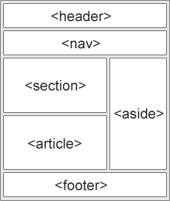
Website Layout

Slide 26
JavaScript

Slide 27
Introduction
JavaScript is a versatile and powerful programming language that runs on web browsers, enabling dynamic and interactive website experiences.
Developed in the mid-1990s, JavaScript has become one of web development's cornerstones.
JavaScript empowers developers to:
Add interactivity
Manipulate content
Respond to user actions in real-time

Slide 28

Why JavaScript
Client-Side Interactivity
Integration with HTML and CSS
Continuous Improvement
Wide Adoption
Versatility
Asynchronous Programming
Browser Support
Open Source Community
Easy to Learn
Notes:
avaScript is an essential language for web development for several reasons:
Client-Side Interactivity: JavaScript is primarily used on the client-side, meaning it runs directly in the user's web browser. It allows developers to create dynamic and interactive web pages, enhancing the user experience.
Wide Adoption: JavaScript is one of the most widely used programming languages in the world. Its popularity ensures a vast community of developers, extensive documentation, and numerous libraries and frameworks for easier development.
Versatility: JavaScript is a versatile language that can be used for a wide range of applications. It is not limited to just web development; it can also be used for server-side development, desktop applications, mobile apps, game development, and even Internet of Things (IoT) projects.
Asynchronous Programming: JavaScript's asynchronous nature enables developers to build responsive and efficient applications. It uses features like callbacks, promises, and async/await to handle time-consuming tasks without blocking the main thread.
Browser Support: All modern web browsers support JavaScript, making it a universal language for web development. This cross-browser compatibility ensures that your code will work consistently across various platforms.
Open Source Community: JavaScript has a vibrant open-source community, contributing to numerous libraries, frameworks, and tools. Developers can leverage these resources to accelerate development and solve common problems.
Frameworks and Libraries: JavaScript has a plethora of powerful frameworks and libraries, such as React, Angular, and Vue.js, which streamline the development of complex web applications and provide a solid foundation for building modern user interfaces.
Easy to Learn: JavaScript has a relatively simple syntax, making it accessible to beginners. It is an excellent language for those starting their programming journey.
Integration with HTML and CSS: JavaScript seamlessly integrates with HTML and CSS, allowing developers to manipulate the DOM (Document Object Model) and apply changes to the webpage's structure and style in real-time.
Continuous Improvement: JavaScript is continually evolving. New language features and improvements are regularly introduced through ECMAScript specifications, ensuring the language remains relevant and up-to-date.
Overall, JavaScript's flexibility, wide adoption, and powerful capabilities make it a fundamental language for building dynamic and interactive web applications, making it a top choice for web developers worldwide.

Slide 29
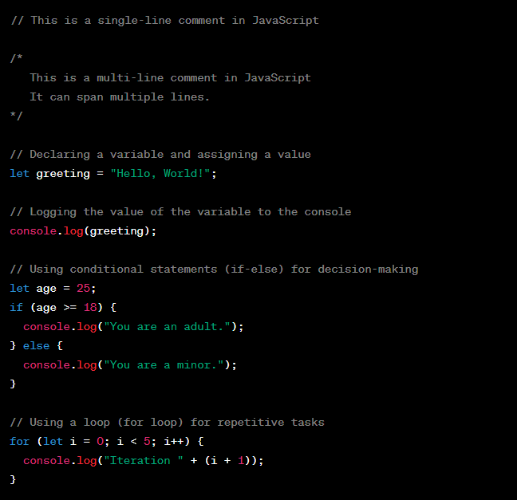
Basic JavaScript Syntax
JavaScript typically consists of statements and expressions.
JavaScript code can be embedded directly into HTML files using <script> tags or included in separate .js files and linked to HTML pages.

Slide 30
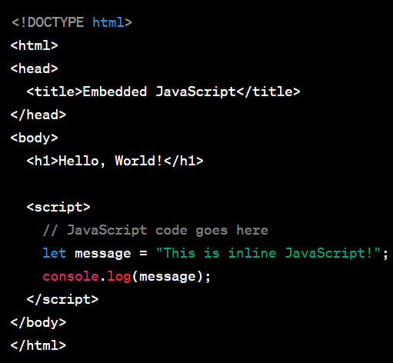
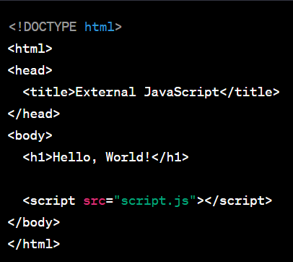
Embedding JavaScript into HTML
Inline JavaScript
External JavaScript File
Embed JavaScript code directly into the HTML file using the <script> tag
Reference an eternal .js file in the src attribute of the <script> tag.

Slide 31
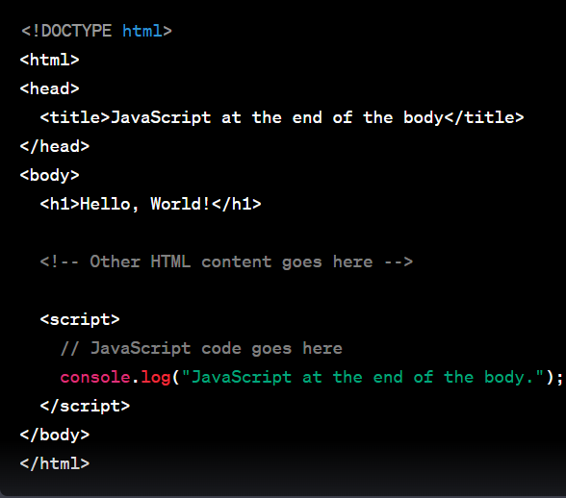
Embedding JavaScript into HTML
Place script tag at the end of the body
For better performance and to ensure that the JavaScript code executes after the HTML content is loaded by ., placing the <script> tag at the end of the <body> element.

Slide 32
Introduction to jQuery
jQuery is a JavaScript library that offers a great deal of flexibility and power to web developers.
Some advantages of jQuery are:
Easy to use and understand, even for novice designers
It can standardize and simplify interactions between HTML elements and JavaScript Code
Provides a wide range of plugins available for various needs
Create dynamic and attractive effects that are like flash, but more SEO- friendly
Lightweight and works in all browsers
Notes:
avaScript is an essential language for web development for several reasons:
Client-Side Interactivity: JavaScript is primarily used on the client-side, meaning it runs directly in the user's web browser. It allows developers to create dynamic and interactive web pages, enhancing the user experience.
Wide Adoption: JavaScript is one of the most widely used programming languages in the world. Its popularity ensures a vast community of developers, extensive documentation, and numerous libraries and frameworks for easier development.
Versatility: JavaScript is a versatile language that can be used for a wide range of applications. It is not limited to just web development; it can also be used for server-side development, desktop applications, mobile apps, game development, and even Internet of Things (IoT) projects.
Asynchronous Programming: JavaScript's asynchronous nature enables developers to build responsive and efficient applications. It uses features like callbacks, promises, and async/await to handle time-consuming tasks without blocking the main thread.
Browser Support: All modern web browsers support JavaScript, making it a universal language for web development. This cross-browser compatibility ensures that your code will work consistently across various platforms.
Open Source Community: JavaScript has a vibrant open-source community, contributing to numerous libraries, frameworks, and tools. Developers can leverage these resources to accelerate development and solve common problems.
Frameworks and Libraries: JavaScript has a plethora of powerful frameworks and libraries, such as React, Angular, and Vue.js, which streamline the development of complex web applications and provide a solid foundation for building modern user interfaces.
Easy to Learn: JavaScript has a relatively simple syntax, making it accessible to beginners. It is an excellent language for those starting their programming journey.
Integration with HTML and CSS: JavaScript seamlessly integrates with HTML and CSS, allowing developers to manipulate the DOM (Document Object Model) and apply changes to the webpage's structure and style in real-time.
Continuous Improvement: JavaScript is continually evolving. New language features and improvements are regularly introduced through ECMAScript specifications, ensuring the language remains relevant and up-to-date.
Overall, JavaScript's flexibility, wide adoption, and powerful capabilities make it a fundamental language for building dynamic and interactive web applications, making it a top choice for web developers worldwide.

Slide 33

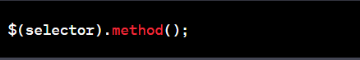
Basic jQuery Syntax
jQuery syntax follows a pattern of selecting HTML elements and performing actions on them. It typically involves a dollar sign $ followed by a set of parentheses ().
Inside the parentheses, you pass a CSS-style selector to target specific elements, and then you chain one or more jQuery methods to perform actions on those elements

Slide 34
Break down the basic jQuery syntax components
$ (Dollar Sign): The dollar sign is an alias for the jQuery function, which is the entry point to use jQuery. It allows you to access and manipulate the selected HTML elements.
selector: The selector is a CSS-style expression that identifies the HTML elements you want to target. It could be a tag name, class name, ID, or any other valid CSS selector.
method: The method is a jQuery function that performs an action on the selected elements. It can be a method to manipulate the elements, handle events, make AJAX requests, or perform animations, among other things.

Slide 35

Embedding jQuery into HTML
Embedding jQuery into an HTML document, requires the jQuery library using a script tag
Download the jQuery library and host it locally or use a content delivery network (CDN) to access the jQuery library online.
Download and Host jQuery Locally
Place the downloaded jQuery file (usually named jquery-x.y.z.min.js, where x.y.z represents the version number) in your project directory.
Link the jQuery file in your HTML file using the <script> tag just before the closing </body> tag.
Use jQuery via CDN (Content Delivery Network):
Instead of downloading the jQuery file, you can use a publicly available CDN to load jQuery into your HTML file. This can reduce the load on your server and benefit from potential caching by widely-used CDNs.

Slide 36
Bootstrap

Slide 37
Introduction
Bootstrap is a popular open-source front-end framework used for building responsive and visually appealing websites and web applications
Key features of Bootstrap:
Responsive Design
CSS Grid System
Pre-styled Components
Customizable Themes
JavaScript Plugins
Browser Compatibility
Extensive Documentation

Slide 38
Why BootStrap
Rapid Development
Responsive Design
Consistency and Uniformity
Cross-Browser Compatibility
Customization Options
Community and Support
Integration with JavaScript Libraries
Continued Development and Improvement
Notes:
Bootstrap is a popular choice for web developers for several compelling reasons:
Rapid Development: Bootstrap provides a robust set of pre-designed HTML, CSS, and JavaScript components, as well as a responsive grid system. This allows developers to quickly build and prototype websites and web applications without starting from scratch. It significantly speeds up the development process.
Responsive Design: In today's mobile-first world, responsive design is crucial. Bootstrap is built with a mobile-first approach, ensuring that websites and applications automatically adapt to various screen sizes and devices. It eliminates the need for developers to create separate codebases for different devices.
Consistency and Uniformity: Bootstrap enforces a consistent and uniform design across the entire project. By using standardized components and styles, developers can maintain a cohesive and professional appearance for the website or application.
Cross-Browser Compatibility: Bootstrap is designed to work seamlessly across all modern web browsers. It handles the intricacies of browser-specific CSS, ensuring consistent behavior and appearance for users.
Customization Options: While Bootstrap provides a default set of styles and components, it is highly customizable. Developers can tailor the framework to match the specific design and branding requirements of their project. Customization options include using different themes, adjusting variables, and selectively including or excluding components.
Community and Support: Bootstrap has a large and active community of developers, which means there are plenty of resources, documentation, and tutorials available. This community support makes it easier for developers to learn and troubleshoot any issues they may encounter.
Accessibility: Bootstrap includes features and practices that make web applications more accessible to users with disabilities. This adherence to accessibility standards helps developers create inclusive and user-friendly experiences.
Integration with JavaScript Libraries: Bootstrap seamlessly integrates with popular JavaScript libraries and frameworks, such as jQuery. This allows developers to add interactive features and functionality to their projects easily.
Time-Tested and Proven: Bootstrap has been around for several years and is widely used by many websites and web applications. Its stability and reliability make it a trusted choice for developers.
Continued Development and Improvement: Bootstrap is actively maintained and updated, ensuring that it remains relevant and up-to-date with the latest trends and best practices in web development.
Overall, Bootstrap provides developers with a powerful toolkit to create responsive, visually appealing, and user-friendly web applications with less effort. Its flexibility, ease of use, and adaptability have contributed to its popularity and wide adoption in the web development community.

Slide 39
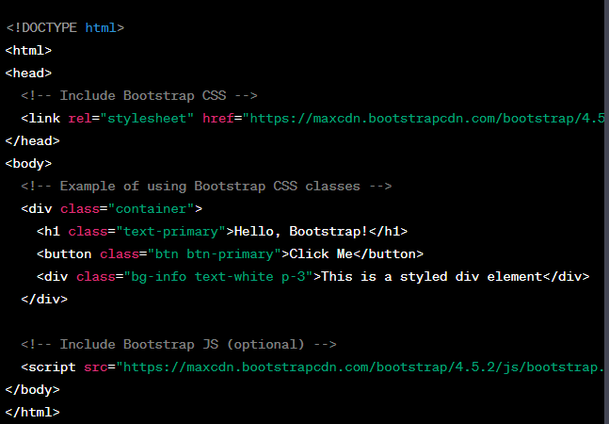
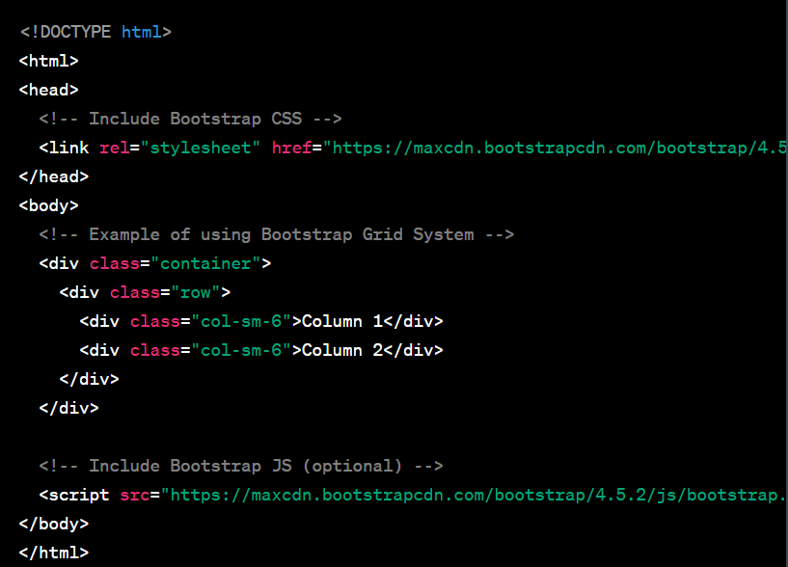
Basic Bootstrap Syntax
Bootstrap is based on HTML, CSS, and JavaScript, so its syntax involves using predefined CSS classes and JavaScript components provided by the framework. Here are some basic Bootstrap syntax examples
Using Bootstrap CSS Classes
Using Bootstrap grid system

Slide 40
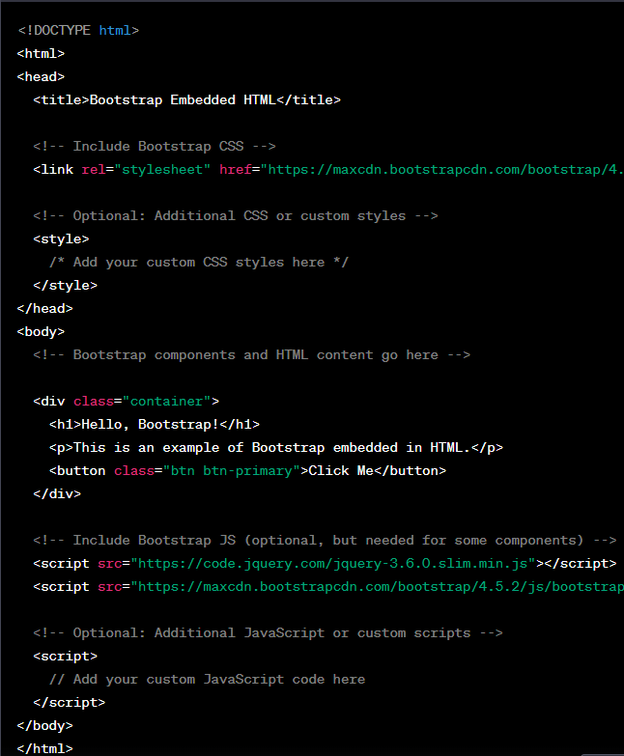
Embedding Bootstrap into HTML
Embedding Bootstrap into an HTML document, requires the necessary Bootstrap CSS and JavaScript files
Download the Bootstrap files and host them locally or use content delivery network (CDN) links to access the Bootstrap files online.
Here's an example of how to embed Bootstrap in an HTML document

Slide 41
Bootstrap Alternatives
1. Tailwind CSS (Free)
2. Bulma(Free)
3. Materialize (Paid)
4. Foundation by Zurb (Paid)
5. Pure CSS (Free)
6. Element(Paid)
7. Skeleton(Free)
8. Metro UI(Freemium)
Notes:
Bootstrap is a popular choice for web developers for several compelling reasons:
Rapid Development: Bootstrap provides a robust set of pre-designed HTML, CSS, and JavaScript components, as well as a responsive grid system. This allows developers to quickly build and prototype websites and web applications without starting from scratch. It significantly speeds up the development process.
Responsive Design: In today's mobile-first world, responsive design is crucial. Bootstrap is built with a mobile-first approach, ensuring that websites and applications automatically adapt to various screen sizes and devices. It eliminates the need for developers to create separate codebases for different devices.
Consistency and Uniformity: Bootstrap enforces a consistent and uniform design across the entire project. By using standardized components and styles, developers can maintain a cohesive and professional appearance for the website or application.
Cross-Browser Compatibility: Bootstrap is designed to work seamlessly across all modern web browsers. It handles the intricacies of browser-specific CSS, ensuring consistent behavior and appearance for users.
Customization Options: While Bootstrap provides a default set of styles and components, it is highly customizable. Developers can tailor the framework to match the specific design and branding requirements of their project. Customization options include using different themes, adjusting variables, and selectively including or excluding components.
Community and Support: Bootstrap has a large and active community of developers, which means there are plenty of resources, documentation, and tutorials available. This community support makes it easier for developers to learn and troubleshoot any issues they may encounter.
Accessibility: Bootstrap includes features and practices that make web applications more accessible to users with disabilities. This adherence to accessibility standards helps developers create inclusive and user-friendly experiences.
Integration with JavaScript Libraries: Bootstrap seamlessly integrates with popular JavaScript libraries and frameworks, such as jQuery. This allows developers to add interactive features and functionality to their projects easily.
Time-Tested and Proven: Bootstrap has been around for several years and is widely used by many websites and web applications. Its stability and reliability make it a trusted choice for developers.
Continued Development and Improvement: Bootstrap is actively maintained and updated, ensuring that it remains relevant and up-to-date with the latest trends and best practices in web development.
Overall, Bootstrap provides developers with a powerful toolkit to create responsive, visually appealing, and user-friendly web applications with less effort. Its flexibility, ease of use, and adaptability have contributed to its popularity and wide adoption in the web development community.

Slide 42
Web Hosting

Slide 43
Introduction
Hosting refers to making a website, application, or any digital content accessible to users over the Internet.
When you host a website or an application, you store the necessary files, data, and resources on a connected server.

Slide 44
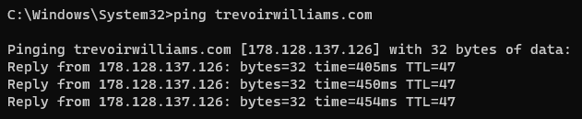
Let’s review some concepts
Domain Name System (DNS) Resolution
the process of converting human-readable domain names, like "www.example.com," into numerical IP addresses that computers use to locate and communicate with each other on the internet.
Web Server
It processes incoming requests from clients (usually web browsers) and sends back the requested web pages, files, or resources to be displayed on the client's device.
SSL (Secure Sockets Layer)
SSL (Secure Sockets Layer) encryption, and its successor TLS (Transport Layer Security), are cryptographic protocols designed to secure the communication between a client (such as a web browser) and a server (such as a web server) over the internet.

Slide 45
How does Web hosting work
SSL Encryption (If Enabled)
Secure Socket Layer (SSL) or Transport Layer Security (TLS) encryption may be used to secure data transmission between the user's browser and the web server
Content Delivery
To ensure efficient and fast content delivery, many web hosting providers use Content Delivery Networks (CDNs)
Response to User Interaction
As users interact with the website, their actions generate requests to the web server
Domain Name System (DNS) Resolution
Request to a DNS server to translate the domain name into an IP address.
Server Processing
The web server receives the request and processes it
1
2
3
4
5
6
7
8
9
10
Interactivity and Dynamic Content
If the website has interactive elements or requires dynamic the web server processes the user's interactions or retrieves the required data from databases or other sources.
Database Integration
If the website includes a backend database (the web server communicates with the database to retrieve, update, or store data as needed
Response and Rendering
The browser receives the requested resources from the server and renders the webpage for the user to see and interact with.
Request to the Web Server
Once the browser obtains the IP address, it sends a request to the web server associated with that IP address
File Retrieval and Rendering
The web server retrieves the requested files from its storage and sends them back to the user's browser over the internet

Slide 46
Web Hosting options
Shared Hosting
Dedicated Hosting
Virtual Private Server (VPS) Hosting
Cloud Hosting
Notes:
Bootstrap is a popular choice for web developers for several compelling reasons:
Rapid Development: Bootstrap provides a robust set of pre-designed HTML, CSS, and JavaScript components, as well as a responsive grid system. This allows developers to quickly build and prototype websites and web applications without starting from scratch. It significantly speeds up the development process.
Responsive Design: In today's mobile-first world, responsive design is crucial. Bootstrap is built with a mobile-first approach, ensuring that websites and applications automatically adapt to various screen sizes and devices. It eliminates the need for developers to create separate codebases for different devices.
Consistency and Uniformity: Bootstrap enforces a consistent and uniform design across the entire project. By using standardized components and styles, developers can maintain a cohesive and professional appearance for the website or application.
Cross-Browser Compatibility: Bootstrap is designed to work seamlessly across all modern web browsers. It handles the intricacies of browser-specific CSS, ensuring consistent behavior and appearance for users.
Customization Options: While Bootstrap provides a default set of styles and components, it is highly customizable. Developers can tailor the framework to match the specific design and branding requirements of their project. Customization options include using different themes, adjusting variables, and selectively including or excluding components.
Community and Support: Bootstrap has a large and active community of developers, which means there are plenty of resources, documentation, and tutorials available. This community support makes it easier for developers to learn and troubleshoot any issues they may encounter.
Accessibility: Bootstrap includes features and practices that make web applications more accessible to users with disabilities. This adherence to accessibility standards helps developers create inclusive and user-friendly experiences.
Integration with JavaScript Libraries: Bootstrap seamlessly integrates with popular JavaScript libraries and frameworks, such as jQuery. This allows developers to add interactive features and functionality to their projects easily.
Time-Tested and Proven: Bootstrap has been around for several years and is widely used by many websites and web applications. Its stability and reliability make it a trusted choice for developers.
Continued Development and Improvement: Bootstrap is actively maintained and updated, ensuring that it remains relevant and up-to-date with the latest trends and best practices in web development.
Overall, Bootstrap provides developers with a powerful toolkit to create responsive, visually appealing, and user-friendly web applications with less effort. Its flexibility, ease of use, and adaptability have contributed to its popularity and wide adoption in the web development community.

Slide 47
Web Hosting Providers
GoDaddy
BlueHost
HostGator
Netlify
Microsoft Azure
Amazon Web Services (AWS)
Many others…
Notes:
Bootstrap is a popular choice for web developers for several compelling reasons:
Rapid Development: Bootstrap provides a robust set of pre-designed HTML, CSS, and JavaScript components, as well as a responsive grid system. This allows developers to quickly build and prototype websites and web applications without starting from scratch. It significantly speeds up the development process.
Responsive Design: In today's mobile-first world, responsive design is crucial. Bootstrap is built with a mobile-first approach, ensuring that websites and applications automatically adapt to various screen sizes and devices. It eliminates the need for developers to create separate codebases for different devices.
Consistency and Uniformity: Bootstrap enforces a consistent and uniform design across the entire project. By using standardized components and styles, developers can maintain a cohesive and professional appearance for the website or application.
Cross-Browser Compatibility: Bootstrap is designed to work seamlessly across all modern web browsers. It handles the intricacies of browser-specific CSS, ensuring consistent behavior and appearance for users.
Customization Options: While Bootstrap provides a default set of styles and components, it is highly customizable. Developers can tailor the framework to match the specific design and branding requirements of their project. Customization options include using different themes, adjusting variables, and selectively including or excluding components.
Community and Support: Bootstrap has a large and active community of developers, which means there are plenty of resources, documentation, and tutorials available. This community support makes it easier for developers to learn and troubleshoot any issues they may encounter.
Accessibility: Bootstrap includes features and practices that make web applications more accessible to users with disabilities. This adherence to accessibility standards helps developers create inclusive and user-friendly experiences.
Integration with JavaScript Libraries: Bootstrap seamlessly integrates with popular JavaScript libraries and frameworks, such as jQuery. This allows developers to add interactive features and functionality to their projects easily.
Time-Tested and Proven: Bootstrap has been around for several years and is widely used by many websites and web applications. Its stability and reliability make it a trusted choice for developers.
Continued Development and Improvement: Bootstrap is actively maintained and updated, ensuring that it remains relevant and up-to-date with the latest trends and best practices in web development.
Overall, Bootstrap provides developers with a powerful toolkit to create responsive, visually appealing, and user-friendly web applications with less effort. Its flexibility, ease of use, and adaptability have contributed to its popularity and wide adoption in the web development community.

Slide 48
Introduction
Netlify is a cloud computing platform that offers a variety of services and tools designed to simplify the process of building, deploying, and managing modern web applications and websites. It's particularly focused on providing a seamless and efficient workflow for web developers.
Key features of Netlify are:
Static Site Hosting
Continuous Deployment
Build Automation
Serverless
Global Scaling

Slide 49
Why Netlify
Easy Deployment Workflow
Static Site Hosting
Continuous Deployment
Serverless Functions
Custom Domains and SSL
Developer-Friendly
Branch Deployments
Scalability
Analytics and Insights
Notes:
avaScript is an essential language for web development for several reasons:
Client-Side Interactivity: JavaScript is primarily used on the client-side, meaning it runs directly in the user's web browser. It allows developers to create dynamic and interactive web pages, enhancing the user experience.
Wide Adoption: JavaScript is one of the most widely used programming languages in the world. Its popularity ensures a vast community of developers, extensive documentation, and numerous libraries and frameworks for easier development.
Versatility: JavaScript is a versatile language that can be used for a wide range of applications. It is not limited to just web development; it can also be used for server-side development, desktop applications, mobile apps, game development, and even Internet of Things (IoT) projects.
Asynchronous Programming: JavaScript's asynchronous nature enables developers to build responsive and efficient applications. It uses features like callbacks, promises, and async/await to handle time-consuming tasks without blocking the main thread.
Browser Support: All modern web browsers support JavaScript, making it a universal language for web development. This cross-browser compatibility ensures that your code will work consistently across various platforms.
Open Source Community: JavaScript has a vibrant open-source community, contributing to numerous libraries, frameworks, and tools. Developers can leverage these resources to accelerate development and solve common problems.
Frameworks and Libraries: JavaScript has a plethora of powerful frameworks and libraries, such as React, Angular, and Vue.js, which streamline the development of complex web applications and provide a solid foundation for building modern user interfaces.
Easy to Learn: JavaScript has a relatively simple syntax, making it accessible to beginners. It is an excellent language for those starting their programming journey.
Integration with HTML and CSS: JavaScript seamlessly integrates with HTML and CSS, allowing developers to manipulate the DOM (Document Object Model) and apply changes to the webpage's structure and style in real-time.
Continuous Improvement: JavaScript is continually evolving. New language features and improvements are regularly introduced through ECMAScript specifications, ensuring the language remains relevant and up-to-date.
Overall, JavaScript's flexibility, wide adoption, and powerful capabilities make it a fundamental language for building dynamic and interactive web applications, making it a top choice for web developers worldwide.

Slide 50
Course Recap
1

Slide 51
What did we learn?
Visual Studio Code
Coding environment
Keyboard shortcuts
Source Control Integration
HTML
HTML Syntax
Best Practices
How to author web pages

Slide 52
What did we learn?
CSS
Inline styling, Internal and External Stylesheets
Best Practices
Bootstrap framework
JavaScript + jQuery
JavaScript Syntax
How to embed JavaScript in HTML
How to use jQuery

Slide 53
What did we learn?
GitHub
Git and commits
Manage code versions
Netlify
Manual Deployment
CI/CD Pipeline
Custom Domains

Slide 54
Next Steps
Practice!!
Do personal projects
Take on small professional projects
Explore more frameworks (Bootstrap and alternatives)
Explore more JavaScript
Check out additional courses
Database Development
ASP.NET Core Development
Azure DevOps
Practice even more!!!!!
Practice Makes Permanent

Slide 55
See You Soon
Trevoir Williams
Software Engineer | Lecturer | Author

